Slide 1
Lecture 6. Concepts of Cellular
Communications 07/10
1. General Principles of Cellular Telephony
2. Introduction
3. Mobile Phone Cells
4. Cellular Phone Concepts
5. Cellular Channel Concepts
6. Call Management
7. 2G Mobile Phones
8. 2G GSM Phones
9. CDMA: IS-95 (Qualcomm)
10. 3G Mobile Phones: Digital Voice and Data
11. UMTS Services
12. W- CDMA
13. Features

Slide 2
1. Multiple access and Multiplexing.
The FDMA access scheme is based on the FDM process, which provides different frequency bands to transmit data-streams.
The TDMA access scheme is based on the TDM process, that provides different time-slots to different data-streams.
G2, G3 & G4 cellular systems are based on a combination of TDMA and FDMA. Each frequency channel is divided into 8 (6) timeslots, 7(5) of which are used for 7(5) phone calls, and 1 for signaling data (MAHO - Mobile Assisted Handoff).
The CDMA scheme is based on spread spectrum, (a wider radio spectrum in Hertz is used to transmit data with low rate. Several messages are sent simultaneously over the same carrier frequency, using different spreading codes.

Slide 3
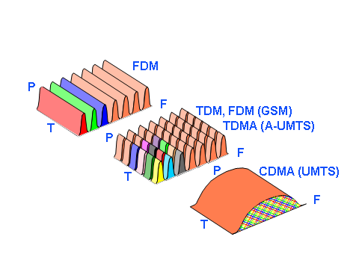
1a. Multiple access and Multiplexing.
Process that permits simultaneous transmissions of multiple signals over one physical circuit.

Slide 4
2. The Mobile Telephone System, Cell Networks
Three main multiplexing schemes:
FDMA, TDMA, and CDMA.
TDMA– IS-54; IS-136 -North American Standard
D-AMPS -Digital Advance Mobile Phone Systems
CDMA- CDMA – Code Division Multiple Access
cdma2000, W-CDMA/UMTS
FDMA- GSM - Pan-European Digital Cellular
(Group Special Mobile); (Global System for Mobile)
PDC - Personal Digital Cellular, Japanese
Iridium-Mobile Communication Satellite
UMTS- Universal Mobile Transport Service

Slide 5
3. Cellular Wireless Network Evolution
CELL
First Generation: Analog Voice (1946)
  AMPS: Advance Mobile Phone Systems (1982)
  Residential cordless phone
  Second Generation: Digital Voice (1990)
  IS-54; IS-136: North American Standard - TDMA (1996)
  IS-95: CDMA (Qualcomm) (1993)
  GSM: Pan-European Digital Cellular (1991)
  Iridium , 2002: Mobile Communication Satellite (1998)
  Third Generation: Digital Voice and Data (2000)
  IMT-2000 (cdma2000, W-CDMA/UMTS)- Combines
  the functions of: Cellular, Cordless, Wireless LANs, Paging, Bluetooth, etc. Supports multimedia services: Data, Voice, Video, Image. (Using VLSI-very large scale integration schemes)
  Fourth Generation (2010)- Internet based

Slide 6
CELL
FDMA
AMPS
NMT
4. Development of different generations of mobile systems
IS-136
D-AMPS TDMA
EDGE
TDMA
IMT-SC
IS-136HS
UWC-136
GSM
PDC
GPRS
IMT-DS
UTRA FDD/W-CDMA
IMT-TC
UTRA TDD/TD-CDMA
IMT-TC
TD-SCDMA
IMT-MC
cdma2000 1XEV-DO
1XEV-DV
CDMA
IS-95
cdmaOne
Cdma2000 1x
GSM – 70% (Europe)
AMPS – 3%
PDC – 5% (Japanese)
CDMA – 12%
TDMA – 10%
1G 2G 2.5G 3G

Slide 7
Cellular phones
Satellites
Crdl.phone
Wireless LAN
CELL
1980
CTO
1981
NMT 450
1982
InmarsatA
1983
AMPS
1984
CT1
199x
proprietary
1986
NMT 900
1991
CDMA
1991
D AMPS
1988
InmarsatC
1987
CTO
1989
CT2
1997
IEEE 802.11
1992
GSM
1992
InmarsatM
1993
PDC
1991
DECT
1998
Iridium
1994
DCS 1800
1999
IEEE 802.11b,
802.15 Bluetooth
2000
GPRS
2001
IMT d-2000
2000
IEEE 802.11a
2010 Fourth Generation (Internet based)
analog
digital

Slide 8
5. Digital Cellular Systems World-wide
CELL
GSM
D-AMPS
Japan Digital
PCS 1900
DCS 1800
CDMA
PCS 1900 (Personal Communication Syst) based on GSM and DCS 1800 (Digital C.S.)

Slide 9
4. Wireless Services
.
.
Cordless
Bluetooth
ZigBee
WiFi
Cellular
CDMA
0.7
1.9
1.7
UMTS; GSM
0.4
1
2
3
4
5
6
GHz
0.80-
0.90
0.90-
0.93
1.85-
1.99
2.39-
2.483
5.72-
5.85
10-66 GHz
0.85-1.90
2.15-2.20

Slide 10
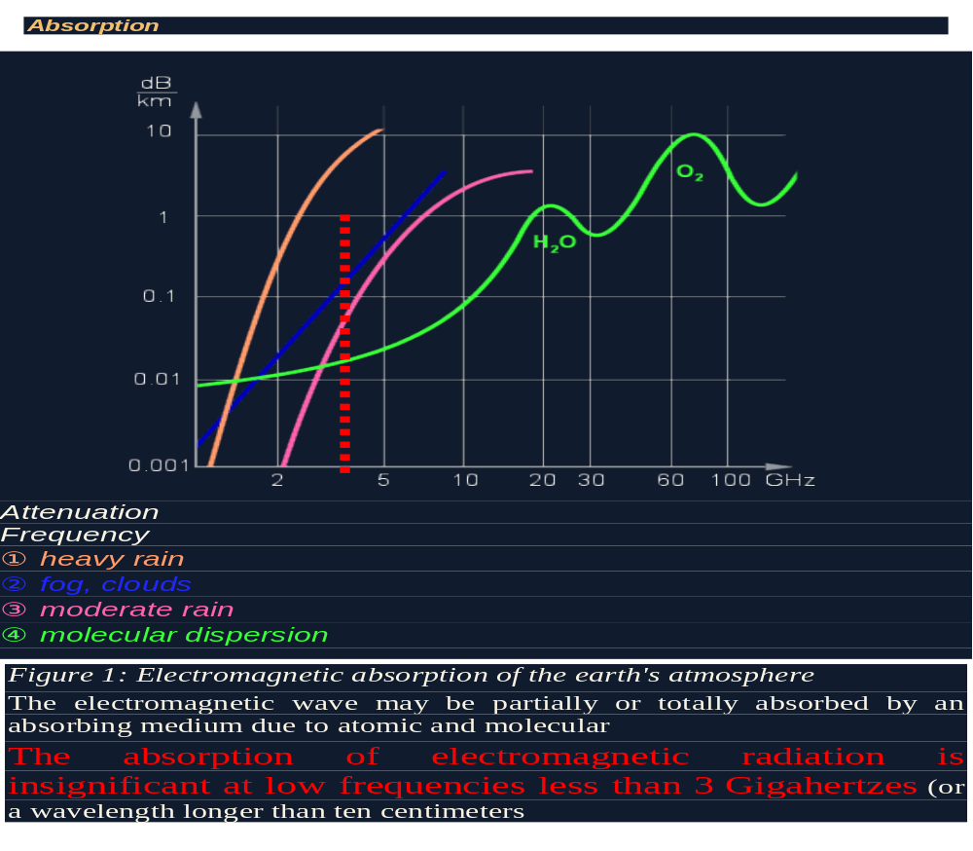
3
G5

Slide 11
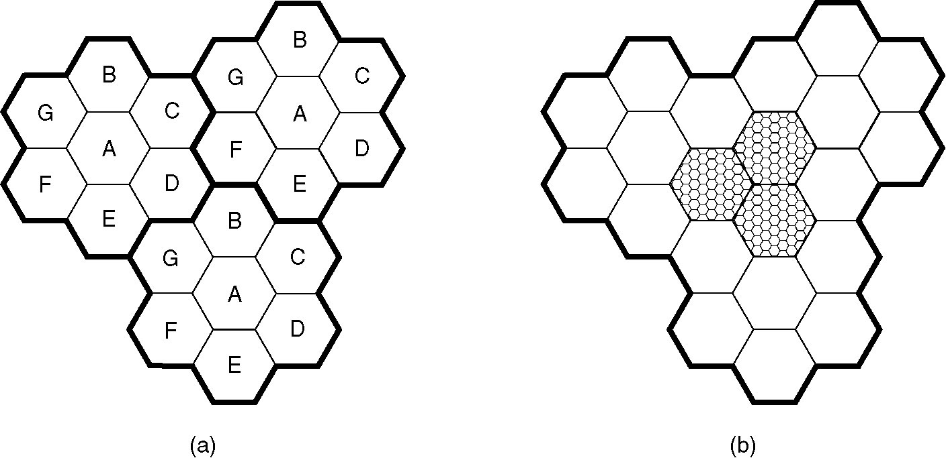
5. Cellular Phone Concepts
Geographical separation
100 cells
CELL
10-20 km
The frequency reuse factor is 1/K=1/7
Each of these cells is assigned multiple frequencies (f1 – fn) and have corresponding radio base stations.
Frequencies are not reused in a group of 7 adjacent cells
To add more users, smaller cells can be used.
In each cell are duplex: uplink and downlink)

Slide 12
7. Cellular Phone Concepts
Geographical separation
Capacity (freq.) reuse
Backbone connectivity
Subject of G5 technology
Hand-held telephone 0.6 watts Car transmitters are 3 watts, Maximum. by the FCC.
CELL
Backbone connectivity
The base station consists of a computers and transmitter/receiver connected to an antenna.
BS
BS
BS
BS
Publ. Swit. Tel. Net.
MTSO (Mobile Telephone Switching office)- MSC (Mobile Switching Center).
BS
BS
BS

Slide 13
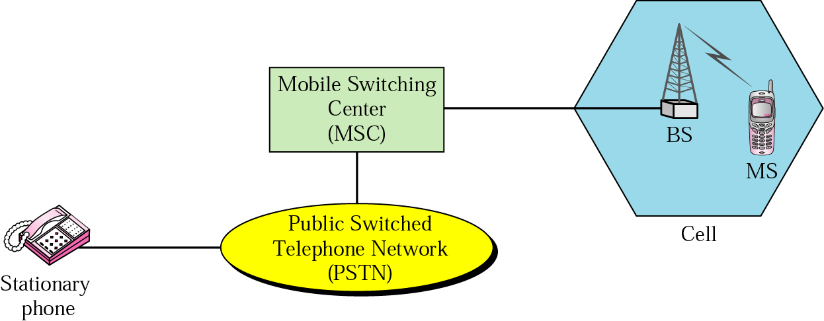
7a. Cellular Phone Concepts (cont)
G5
CELL
Fiber optic cable
MSO, the nerve center of the system
Backbone connectivity
If MS leave a cell, its BS asks the surrounding BS how much power they are getting from it. The BS then transfers ownership to the cell getting the strongest power

Slide 14
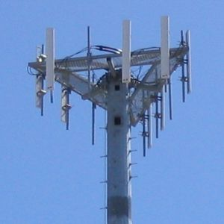
The frequency reuse factor is 1/K where K is the number of cells which cannot use the same set of f for transmission.
Common values for the frequency reuse factor are 1/3, 1/4, 1/7, 1/9 and 1/12 (or 3, 4, 7, 9 and 12 depending on notation).
N sector antennas can serve N different sectors. N is typically 3. A reuse pattern of N/K. Current reuse patterns are 3/7 (North American AMPS), 6/4 (Motorola NAMPS), and 3/4 (GSM).
If the total available bandwidth is B, each cell can only use a number of frequency channels corresponding to a bandwidth of B/K, and each sector can use a bandwidth of B/NK.

Slide 15
8. Routing for Mobile Hosts (cont)
Mobil host
Wireless cell
Home agent
Migrat host
Roaming
Home LAN
CELL
WAN
Foreign
Agent (FA)
PSTN
MAN
Stationary hosts (SH); Migratory hosts (MH); Roaming host (RH)
Foreign agent (FA) keep track of all MH visiting the area

Slide 16
9. MH registration procedure
a). Periodically, each FA broadcasts a packet announcing its existence and address. A newly-arrived MH may:
1) wait for these messages, or
2) MH can broadcast a packet: “Are there any FA around”?
b) The MH registers with the FA its home address, current
DLL address, and some security information.
c) The FA contacts the MH’s HA and says: One of your host
is over here. The message from the FA to the HA contains
the FA’s network address. It also includes the security information to inform the HA that the MH is there.
d) The home agent examines the security information, to prove that it was generated within the past few seconds. If it is happy, it tells the FA to proceed.
e) When the FA gets the ACK from the HA, it makes an entry in its tables and informs the MH that it is now registered.

Slide 17
M2
M1-2
Logical communication
M1
MSC
FDMA >???; FDMA/ TDMA >??? CDMA >???

Slide 18
9. Handoff (Cellular Concepts, cont)
Handoff: Transfer of a MS from one cell to another (0.3 sec.)
(Each BS constantly monitors the received power from each MS).
When power drops below threshold, BS asks neighbor BS
(with stronger received power) to pick up the MS, on a new channel, (the old is not reused in adjacent cells) - handoff.
Hard handoff: User must switch from one frequency to another. The old BS drops the MS before the new one acquires it. If the new one is unable to acquire it, the MS is disconnected abruptly.
Soft Handoff: The MS is acquired by the new BS before the previous one drops (available only with CDMA), the MS needs to be able to tune to two frequencies at the same time.
Neither first nor second generation devices can do this.
CELL

Slide 19

9a. Handoff (Cellular Concepts, cont)
CELL
Soft Handoff: simultaneous radio link between MS and different BSs
Hard handoff: The old BS drops the MS before the new one acquires it.

Slide 20
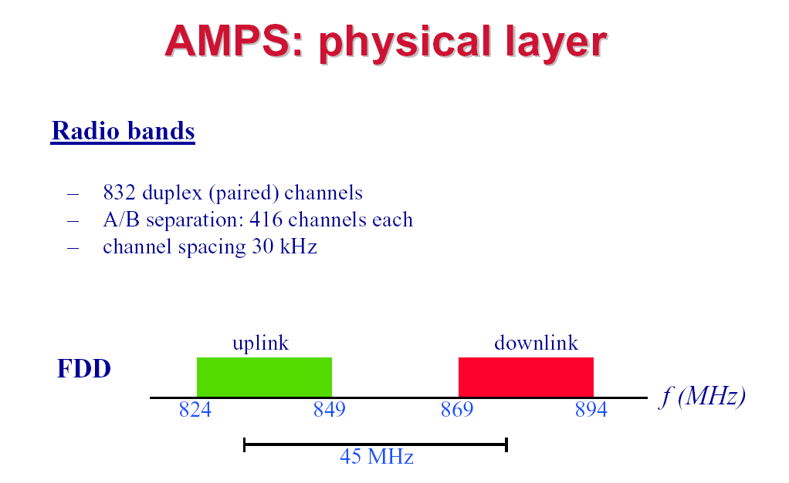
10. Cellular Channel Concepts
CELL
AMPS uses FDD to separate the channels.
Each simplex channels is 30 KHz wide. 832 x 30 =24960 KHz
(A) 832 channels (B) 832 channels
U
D
(Freq Division
Duplex)
25 MHz

Slide 21
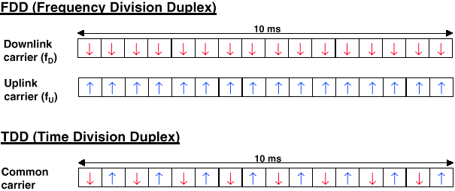
FDD & TDD duplexing
CELL

Slide 22
10c. Channel Categories
AMPS
CELL
832 channels are divided into four categories:
1. Control (BS to MS) (=21) to manage the system (PSK) channels are reserved for control, and are wired into a Programmable Read-Only Memory (PROM)
2. Access (bidirectional) for call setup and channel assignment channels “U” and “D”.
3. Paging (BS to MS) to alert users to calls for them.
4. Data (bidirectional: “U” and “D”) for voice, fax, or data. (FM)

Slide 23
BS
Control
(21) PSK
Paging
(call alert)
Data (FM)
4
2
Access
(fu; fd)
1
3
MS

Slide 24
10d. Call Management:
To register and make a phone call
A. Each MS has a 32-bit serial number and a 10-digit phone number in its PROM.
1. When phone is switched ON, it scans a PROM list of 21 control channels to find the most powerful signal.
2. PROM transmits its ID number to the (MSC) – which informs the home MSC (registration is done every 15 min).
B. To make a call, user transmits destination Ph # on access channel; MSC will assign an idle data channel (frequency)
1. At the same time MSC pages the destination cell for the other party (idle phone listens on all page channels).
2. All the control information, is sent in digital form, multiple times, and with an error-correcting code, even though the voice channels themselves are analog.

Slide 25
10e. Incoming calls
CELL
C. To accept Incoming calls, all idle phones continuously listen to the paging channel to detect messages directed to them. When a call is sent to a MS, a packet is sent to the caller’s home MTSO to find out where it is. A packet is then sent to the BS in its current cell, which then sends a broadcast on the paging channel of the form “Unit 14, are you there?” The called phone then responds with “Yes” on the access channel. The BS then says something like “Unit 14, call for you on Data channel U and channel D”. At this point, the called phone switches to channel U and D and starts making ringing sound.

Slide 26
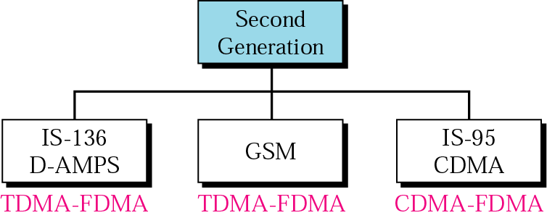
11. cellular phone systems
CELL

Slide 27
11a. 2G; Phones: Digital Voice
Four systems are: D-AMPS, GSM, CDMA, and PDC
(Personal Digital Cellular, Japanese)
FDD: 1850-1910 MHz Upst.; 1930-1990 MHz Downst.
Waves are 16 cm long, ¼-wave antenna is 4 cm long.
D-AMPS can use both the 850 MHz and 1900 MHz bands.
The voice signal picked up by the microphone is
digitized and compressed.
The compression is done in the telephone.
3 users can share a single frequency pair
using TDM. Each frequency pair supports 25 frames/sec
of 40 msec each.
Each of 25 frames is divided into 6 time slots of 6.66 msec each, (6.66msec x 6=39.96 msec); Data Modulation: PCM
1 | 2 |  |  |  |  |  |  |  | 25
 |  |  |  |  | 6
40 msec
6.66 x 6= 40 msec
1 sec

Slide 28
FDMA
10.b D-AMPS, or IS-136, is a digital cellular phone system using TDMA and FDMA.
CELL
TDM
s₁(t)
S₁(f)
S₂(f)
S_{N}(f)

f₁
+
f₁
f₂
f_{N}
f
s_{N}(t)

Narrow single-user bandwidth
f_{N}

Slide 29
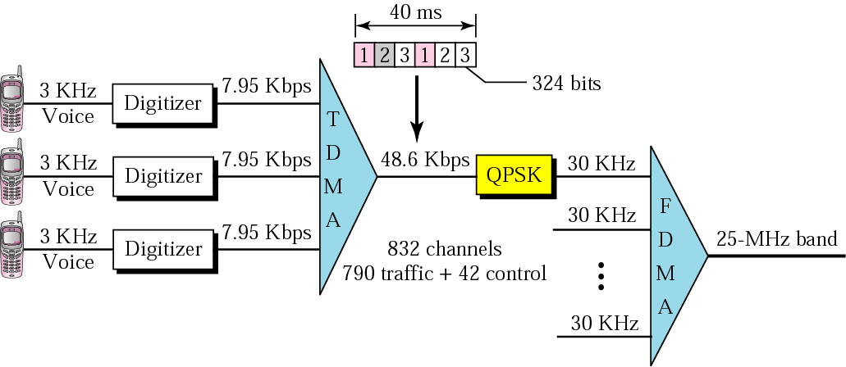
11c. D-AMPS
CELL

Slide 30
(a) D-AMPS Data channel with three users. (b) D-AMPS channel with six users
D-AMPS
CELL
TDM frame
40 msec
TDM frame
40 msec
1850.01 Mhz
MS-BS
1930.05 Mhz
BS-MS
Upstrm
Downst
1
2
3
1
2
3
1
2
3
4
5
6
1850.01 Mhz
MS-BS
1930.05 Mhz
BS-MS
users
3
1
2
3
1
2
6
1
2
3
4
5
1/3 of time a MS is idle = line quality measurement
1/6 of time a MS is idle = line quality measurement
It uses these idle slots to measure the line quality. It takes about 0.3 sec to do the handoff. =MAHO (Mobile Assisted Handoff).

Slide 31
12. D-AMPS; IS-54, IS-136
D-AMPS
Channel multiplxg | FDMA +6 TDM slots
Uplink (initially) (later) | 824-849 MHz; 832 channels (x 6=4992) 1850-1910 MHz
Downlink (initially) (later) | 869-894 MHz; 832 channels (x 6=4992) 1930-1990 MHz
Channel BW | 30 kHz
FDD separation | 45 MHz
Modulation | FM (traffic, voice); PSK (control) PCM
Channel Rate | 48.6 kbps
Voice compression | 56 kbps to 8 kbps; PCM
TDM frames | 25 frames, 40 msec each
Time slots | 6 slots, 6.67 msec each; (25x6=150 msec)
CELL

Slide 32
13. 2G; GSM Phones
(Group Special Mobile)
(Global System for Mobile)
GSM
CELL
Pan-European Cellular Standard: 2G; Digital
FDD: (890-915 MHz Upstr; 935-960 MHz Downstr.)
124 frequency carriers; 8 channels per carrier
Carrier spacing: 200 KHz (Narrowband TDM)
Modulation: PSK
FHSS modulation (217.6 hops/s) to overcome
multipath fading.
First approximation, GSM is similar to
D-AMPS.
See #29 #31

Slide 33
14. 2G- GSM is similar to
2G- D-AMPS.
CELL
D-AMPS is used in the U.S. and in Japan (modified). Everywhere else in the world used GSM
GSM | D-AMPS
FDM | FDM
Dual simplex channels | Dual simplex channels
Single frequency pair is split by TDM (8) | Single frequency pair is split by TDM (6)
Channel 200 kHzwide | Channel 30 kHz wide
Higher data rate

Slide 34
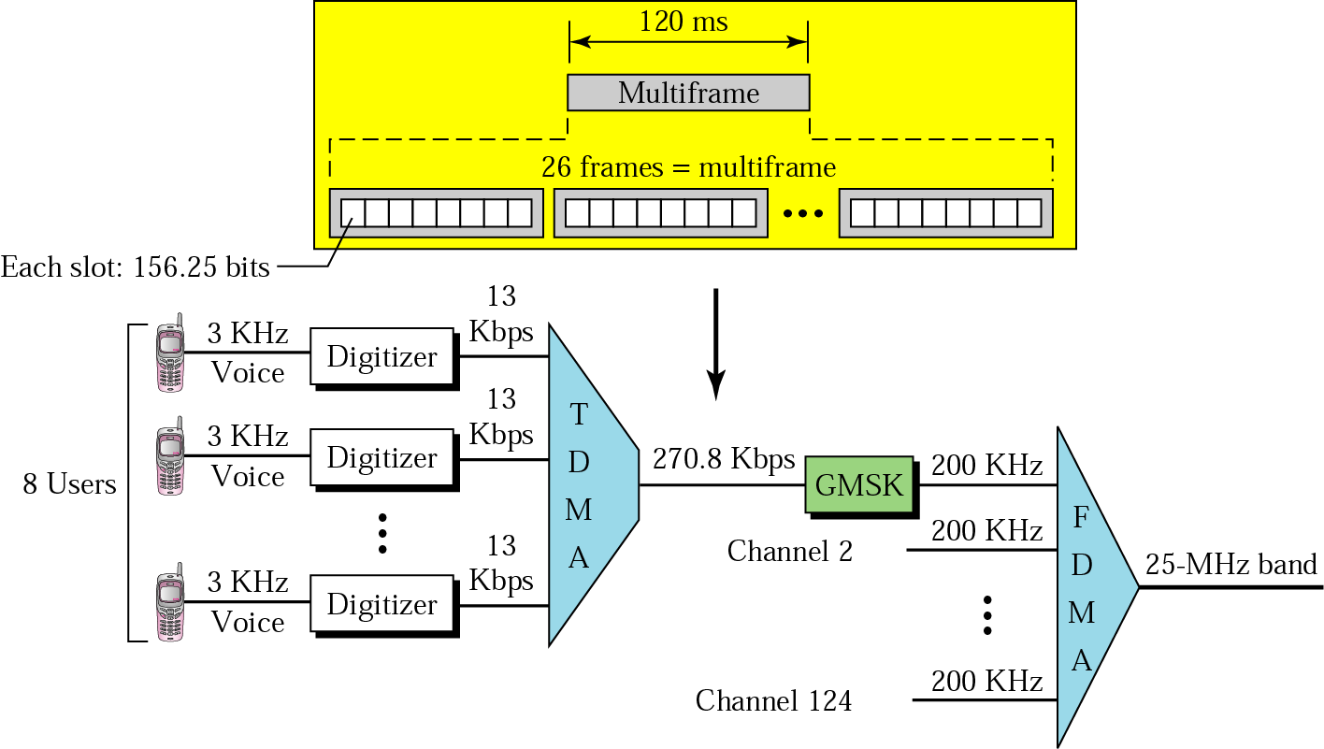
GSM (cont)
8 slots
CELL
Compare with slide #27 & #29

Slide 35
GSM system
CELL
A GSM system has 124 pairs of simplex channels;
Each 200 kHz wide.
Supports eight separate slots, using TDM
Each active station is assigned one time slot on one channel pair.
992 channels (124x8) can be supported in each cell, but many of them are not available, to avoid frequency conflict with neighboring cells.
Transmittion and receiving does not happen in the same time slot because the GSM radios cannot transmit and receive at the same time and it takes time to switch from one to the other.
GSM

Slide 36
Control Channels (CC)
GSM
CC used to manage the system.
The broadcast control channel (BCC) is a continuous stream from the BS containing the BS’s identity and the channel status. All MS monitor their signal strength.
The dedicated control channel (DCC) is used for location updating, registration, and call setup. In particular, each BS maintains a database of MS. Information needed to maintain this database.
The common control channel (CCC), which is split up into three logical sub-channels:
The paging channel CC3a), which the BS uses to announce incoming calls. Each MS monitors it continuously to watch for call it should answer.
The random access channel (CC3b). This allows users to request a slot on the dedicated control channel. If two requests collide, they are garbled and have to be retried.
The access grant channel (CC3c). Announces assigned slot.
CELL

Slide 37
GSM;
Compare with slide 31
Channel multiplexing | FDM+8 TDM slots
Uplink (GSM900) (DCS1800) | 890-915 MHz; 125 channels (x8=1000) 1710-1785 MHz
Downlink (900) (DCS1800) | 935-960 MHz; 125 channels (x8=1000) 1805-1880 MHz
Channel Bandwidth | 200 kHz
FDD separation | 45 (900) / 95 (1800) MHz
Modulation | FSK
Channels | Brdcst. Cont; Ded. Cont; Comn. Cont.= =Paging.+Rndm. Access+Acc. Grnt.
Channel Rate | 13 kbps
TDM frames | 24 frames, 120 msec each
Time slots | 8 slots, 0.577 msec each; (24x8=192)
CELL

Slide 38
14. CDMA: IS-95; (QUALCOMM)
CDMA
Based on DSSS
Two frequency bands (1.25 MHz), one for forward channel (cell-site to subscriber) and one for reverse channel (subscriber to cell-site)
Sprint PCS = CDMA;
AT&T + Wireless = D-AMPS.
CDMA allows reuse of same spectrum over all cells. Network capacity improvement:
CELL
IS-95 is a digital cellular phone system using CDMA/DSSS.

Slide 39
14a. CDMA (cont)
CDMA
CDMA is different from D-AMPS, and GSM.
Instead of FDM each with hundreds narrow channels (GSM; D-AMPS), CDMA each station transmits over the entire frequency spectrum all the time.
Multiple transmissions are separated by unique “code” for each user;=code set partitioning
All users share same frequency, but each user has own “chipping” sequence (i.e., code) to encode data.
Chipping rate > data rate
Encoded signal = original data bit X chipping sequence
Decoding= inner product of encoded signal X chipping sequence
allows multiple users to “coexist” and transmit
CELL

Slide 40
14c. CDMA (cont)
CDMA
Each bit time is subdivided into m short intervals called chips. Typically: m=8, 64 or 128 chips / bit.
Each station is assigned a unique m-bit code called a chip sequence. For m=8, if station A is assigned the chip sequence 00011011, it sends a 1 bit by sending 00011011 and a 0 bit by sending complimentary 11100100.
Increasing the amount of information b bits/sec to mb chips/sec can only be done if the bandwidth available is increased by a factor of m,
With GSM; D-AMPS If we have a 1-MHz band available for 100 stations, with FDM each station would have 10 kHz BW, and could send at 10 kbps (assuming 1 bit/Hz).
With CDMA, each station uses the full 1 MHz, so the chip rate is 1 m chip/sec. (With fewer then 100 chips per bit, (calculation-100 x 8=800 KHz) the effective bandwidth per station is higher for CDMA than FDM.
CELL

Slide 41
Digital 1
Digital 0
t
t
chip sequence for digital 1
chip sequence for digital 0
t
t
8
b x 8
8

Slide 42

14b. CDMA: two-sender interference
CDMA
CELL
a
b
2b x 8 =16
a’s code

Slide 43
CDMA (cont’d)
CDMA
Each transmitting station gets its own chip sequence. The receiver must know station’s chip sequence in advance.
Receiver listens all the senders at once by running the decoding algorithm for each of them in parallel.
CDMA is typically used for wireless systems (no Ad Hoc). The power levels received at the BS depend on how far away the transmitters are.
CDMA operates in a band of 1.25 MHz (versus 30 kHz for D-AMPS and 200 kHz for GSM), but it supports many more users in that band than either of other systems.
In practice, the bandwidth available in CDMA for each user often is much better than for GSM.

Slide 44
15. CDMA: cell breathing
Uniform traffic distribution and low load: MS Tx power depends mainly on path loss.
Raising traffic in a cell: users in that cell are forced to increase the Tx power level in order to react to increased interference.
Cell B
Cell A
CELL
Cell B
Cell A

Slide 45
CDMA: cell breathing
CDMA
It is possible that Tx power used by some users is higher than that sufficient to be received by the unloaded cell, even though it is at a higher path loss.
Served area of the two cells varies as a function of the relative load, because in the unloaded cell also farther connections can be kept at low power.
Cell B
Cell A
CELL
Cell B
Cell A

Slide 46
16. Third-Generation Mobil Phones;
3G
3rd called IMT-2000; (1992)
1. The year into service;
2. Operate frequency (in MHz),
3. The bandwidth (in kHz).
Finally: 2Mbps has problems, due to the difficulty of performing handoff quickly.
More realistic is: 2 Mbps for stationary indoor users,
384 kbps for walking, and
144 kbps for connections in cars.
IMT-2000 network basic services:
1. High-quality voice transmission.
2. Messaging (replacing e-mail, fax, chat, etc.).
3. Multimedia (music, viewing videos, films, televisions).
4. Internet access (Web, pages with audio and video).
CELL

Slide 47
17. CDMA2000
CELL
Key features:
CDMA2000 system uses one or more available 1.25 MHz channels for each direction.
1. Higher Data Throughput. Today's commercial CDMA2000 networks support a peak data rate of 2.4 Mbps.
2. Frequency Band Flexibility. CDMA2000 networks have been arranged in the 450, 800, 1700, and 1900 MHz bands.
3. CDMA2000, (Qualcomm). It uses a DSSS design, basically an extension of IS-95; With backward compatible with IS-95; It also uses a 5-MHz bandwidth. NOT interworks with GSM; Cannot hand off calls to a GSM cell (or D-AMPS).

Slide 48
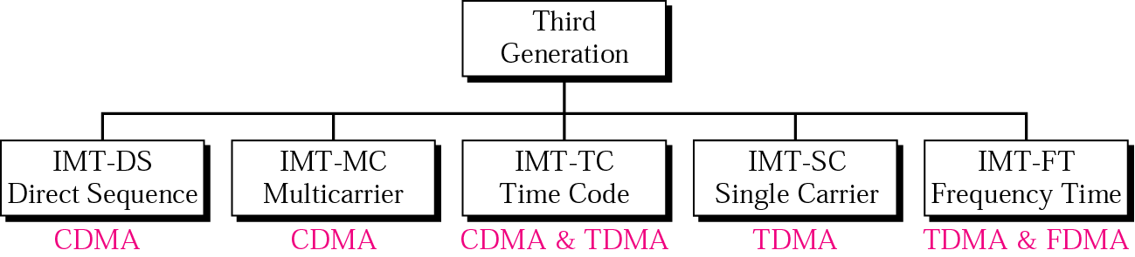
18. 3G Cellular Phone Systems
The main goal of third-generation cellular telephony is to provide universal personal communication.
CELL
IMT - International Mobile Telecommunications

Slide 49
19. UMTS
CELL
Requirements
384 Kbps for full area coverage
2 Mbps for local area coverage
variable bit rate
packet traffic support
flexibility (eg, multiple, multimedia streams on a single connection)
UMTS system uses DSSS; It runs in a 5 MHz band;
Interworks with GSM networks, but not vise versa.
CDMA
UMTS
GSM
No interwork
GSM
CDMA
CDMA
UMTS

Slide 50
20. Cellular Evolution (cont)
  Third Generation (3G) : W-CDMA
  Combines the functions of: cellular, cordless, wireless LANs, paging etc.
  Supports multimedia services (data, voice, video, image)
  Before full 3G was designed high performance systems (2.5G):
  (a) GPRS (for GSM)
  (b) EDGE (for GSM)
  (c) 1xRTT (for CDMA)
  - the final system: UMTS, CDMA 2000, WCDMA
CELL

Slide 51
21. Universal Mobile Telecommunications System (UMTS)
UMTS Is a third generation mobile cellular system for networks based on the GSM standard. UMTS is a component of the International Telecommunications Union IMT-2000 standard set and compares with the CDMA2000 standard set for networks. UMTS uses wideband code division multiple access (W-CDMA) radio access technology to offer greater spectral efficiency and bandwidth.
UMTS specifies a network system, which includes the radio access network and the authentication of users via SIM (subscriber identity module) cards.
CDMA2000 (IMT Multi-Carrier), and UMTS requires new base stations and new frequency allocations.
The CDMA scheme is based on SS, meaning that a wider spectrum in Hertz is used than the data rate of each of the transferred bit streams, and several message signals are transferred simultaneously over the same carrier frequency, utilizing different spreading codes. The wide bandwidth makes it possible to send with a very poor signal-to-noise ratio of much less than 1 (less than 0 dB) according to the Shannon formula, meaning that the transmission power can be reduced to a level below the level of the noise and co-channel interference (cross talk) from other message signals sharing the same frequency. One form is direct sequence spread spectrum (DS-CDMA), used for example in 3G cell phone systems.

Slide 52
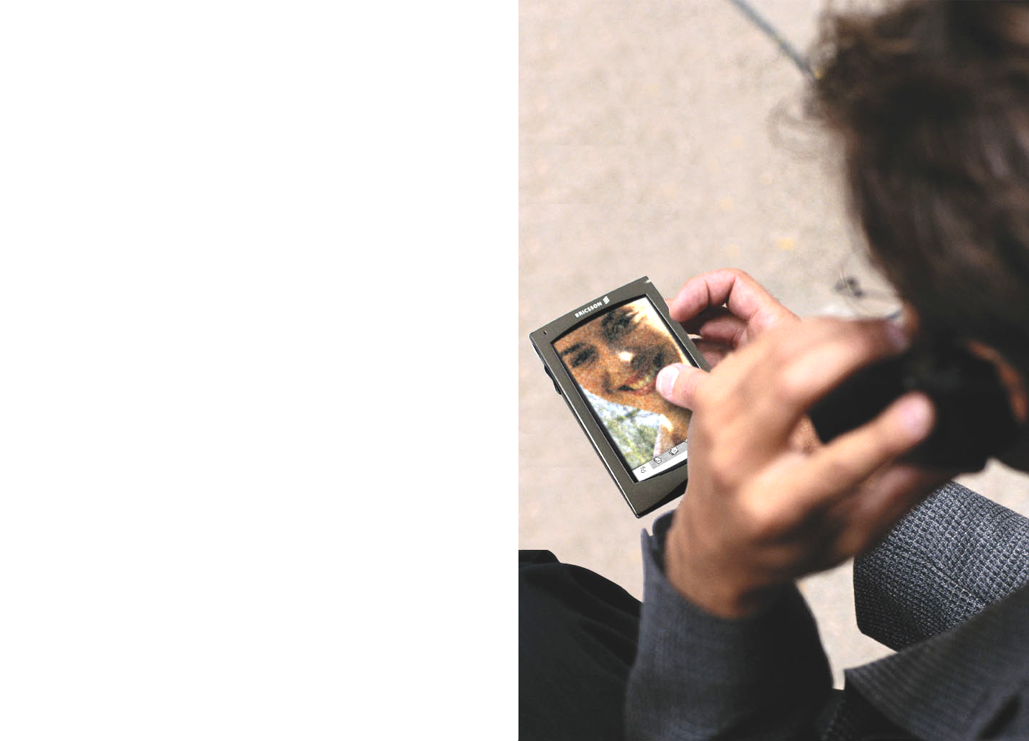
UMTS services
3G
CELL
Videoconference
Video streaming
Video on demand

Slide 53
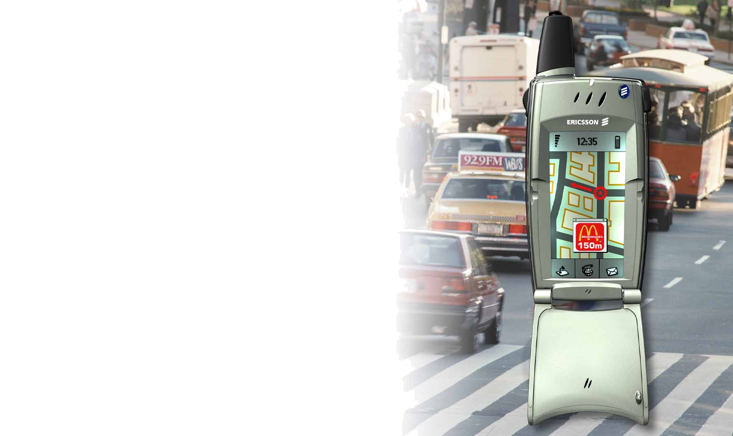
UMTS services
3G
Interactive Map
Localization Service
Navigation System
…
CELL

Slide 54
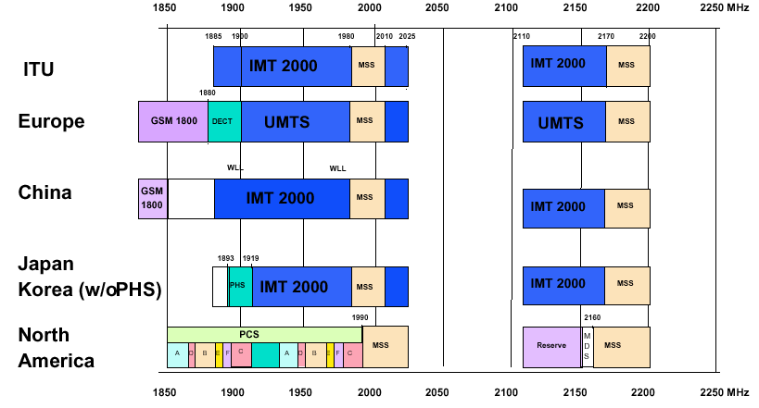
UMTS frequency map 3G & 4G
CELL

Slide 55
23. 4G is a successor to the 3G and 2G families
In 2008, the ITU-R specified the IMT-Advanced requirements for 4G standards, setting peak speed for 4G service at 100 Mbs for high mobility communication (such as from trains and cars) and 1 Gbps for low mobility communication (stationary users).
LTE (Long-Term Evolution) for commonly marketed as 4G LTE, is for wireless communication of high-speed data for mobile phones. It is based on the:GSM/EDGE & UMT/HSPA network technologies, the capacity and speed using a different radio interface. First available LTE service was launched on December 14, 2009.
A 4G system provide a comprehensive and secure all-IP-based mobile solution to laptop computer, smart phones and other mobile devices. Facilities such IP telephony, gaming services, and streamed multimedia provided to users.

Slide 56
4G is a smartphone with Operating System.
In 1999 released the first smartphones, combined telephony and computing, it became widespread in the late 2000s. Smartphones have the ability to: place and receive voice/video calls and create and receive text messages, have personal digital assistants, a media player, video games, GPS navigator, digital camera and digital video camera.
Smartphones can access the Internet through cellular frequencies or WiFi. They have a color display with a graphical user interface. The display is almost always a touch-screen and sometimes additionally a touch-enabled keyboard to type words and numbers and press.
Worldwide operating system market share for
Android iOS Windows Others
81.7% 17.9% 0.3% 0.1%

Slide 57
Mobile operating systems
Android is a mobile operating system developed by Google. It is an open source platform with proprietary components.(2008).
iOS (iPhone OS) is a proprietary mobile operating system developed by Apple Inc. primarily for its iPhone product line. The iPhone was first unveiled in 2007. The device introduced design concepts that have been adopted by modern smartphone platforms.
Windows 10 Mobile (Windows Phone) is from Microsoft. It is closed source and proprietary. It has the third largest installed base on smartphones behind Android and iOS (2010).
It is integrated with Microsoft services such as OneDrive and Office, Xbox Music, Xbox Video, Xbox. Also integrated with many other non-Microsoft services such as Facebook and Google accounts.

Slide 58
Discontinued operating systems
BlackBerry 10 (In early 2010s), is based on their BlackBerry Tablet OS, to replace the BlackBerry OS. While the company has started to release smartphone based on the Android operating system.
BlackBerry OS (In 1999), RIM released its first BlackBerry devices, providing secure real-time push-email communications on wireless devices. Services such as BlackBerry Messenger provide the integration of all communications into a single inbox.
Windows Mobile. Windows Mobile was based on the Windows CE kernel and first appeared as the Pocket PC 2000 operating system. Throughout its lifespan, the operating system was available in both touch-screen and non-touch-screen formats.
Firefox OS was demonstrated by Mozilla in February 2012. It was designed to have a complete community-based alternative system for mobile devices, using open standards and HTML5 applications.
Ubuntu Touch (Ubuntu Phone) is a mobile version of the Ubuntu operating system developed by Canonical UK Ltd and Ubuntu Community. It is designed primarily for touchscreen mobile devices such as smartphones and tablet computers.

Slide 59
5th generation wireless systems
5G are the proposed next telecommunications standards beyond the current 4G/IMT-Advanced standards.
5G planning aims capacity > than current 4G, supporting device-to-device and massive machine communications.
5G research and development also aims at lower latency than 4G equipment and lower battery consumption.
There is currently no standard for 5G deployments.
The Next Generation Mobile Network Alliance defines the following requirements that a 5G standard should fulfill:
*Data rates of tens of Mbps for tens of thousands of users.
*Data rates of 100 Mbps for metropolitan areas.
*1 Gbps simultaneously to many workers on the same office floor
5G should be rolled out by 2020

Slide 61
G1-G5
New mobile generations are typically assigned new frequency bands and wider spectral bandwidth per frequency channel (1G up to 30 kHz, 2G up to 200 kHz, 3G up to 5 MHz, and 4G up to 20 MHz).
The higher frequencies would overlap with transmissions of communication satellites.
Previous mobile generations have substantial increase in bit rate (i.e. physical layer) up to 1 gigabit per second to be offered by 4G.
The U.S. Federal Communications Commission (FCC) approved the spectrum for 5G, including the 28 GHz, 37 GHz and 39 GHz bands, on July, 2016. (see slide 10).

Slide 62
G1-G5
1.
2.
3. G1 f=0.9MHz; G2 f=1.9Mhz; G3 f=2.4GHz;
G4 f=5.8 GHz; G5 f=28GHz,37GHz & 39GHz
4.
?. Using 1. + 2. +3. +4 concepts, what you can
conclude for G5 network ???
G2, 15 km
FCC restriction for Hand-held telephone =0.6 watts

Slide 63
Has been recorded three very distinct 5G network visions:
A super-efficient mobile network that delivers a better performing network for lower investment cost.
A super-fast mobile network comprising the next generation of small cells densely clustered to give a contiguous coverage over at least urban areas and getting the "wide-area mobility."
A combined fiber-wireless network that uses, for the first time for wireless Internet access, the millimeter wave bands (20 – 60 GHz) that allow very-wide-bandwidth radio channels able to support data-access speeds of up to 10 Gbs.
The connection essentially comprises "short" wireless links on the end of local fiber optic cable.
See slides 12 & 13

